Slide 1

Higgs Boson Machine Learning Challenge
Miaozhi YU, Shuo ZHANG, Bin FANG, Chuan SUN
Aug. 30, 2016

Slide 2
Outline
Workflow
Exploratory Data Analysis
Models
Random Forests
Generalized Boosted Model
Neural Networks
XGBoost
Lesson Learned

Slide 3
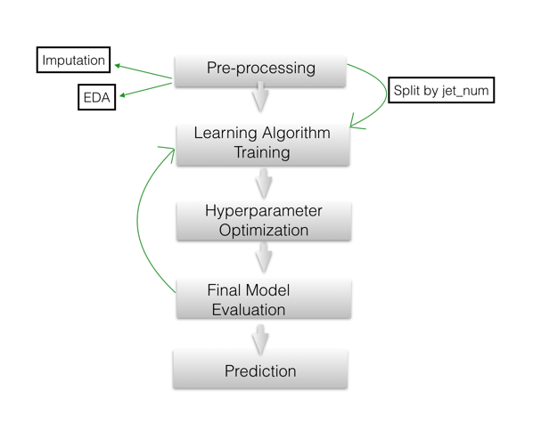
Workflow

Slide 4
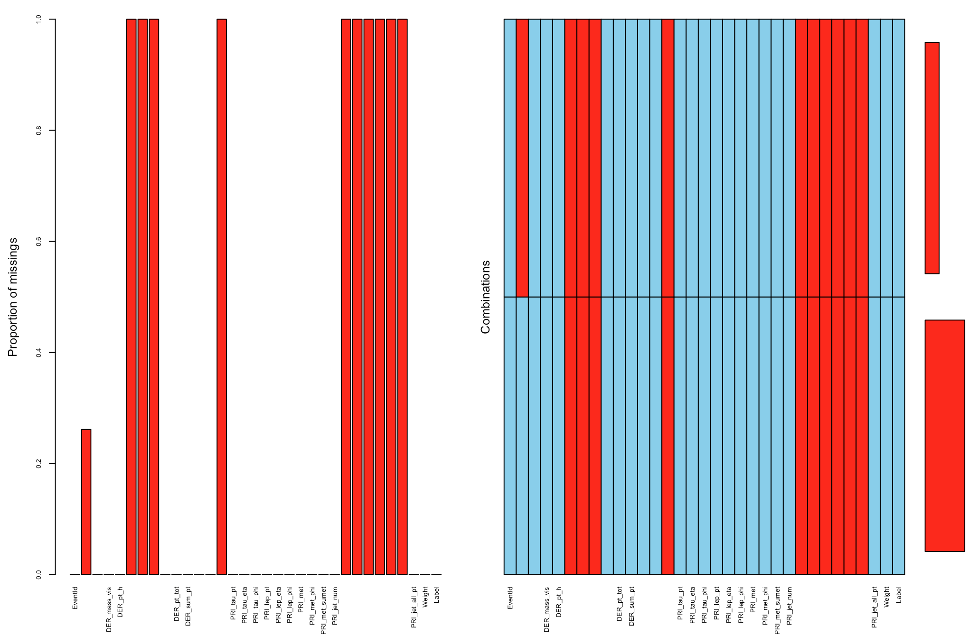
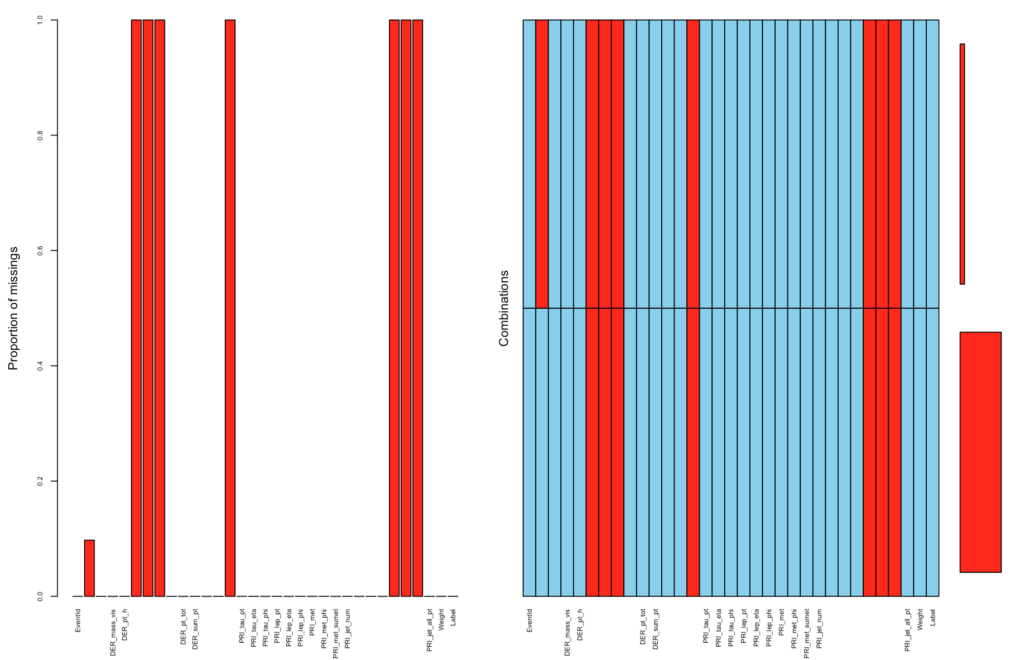
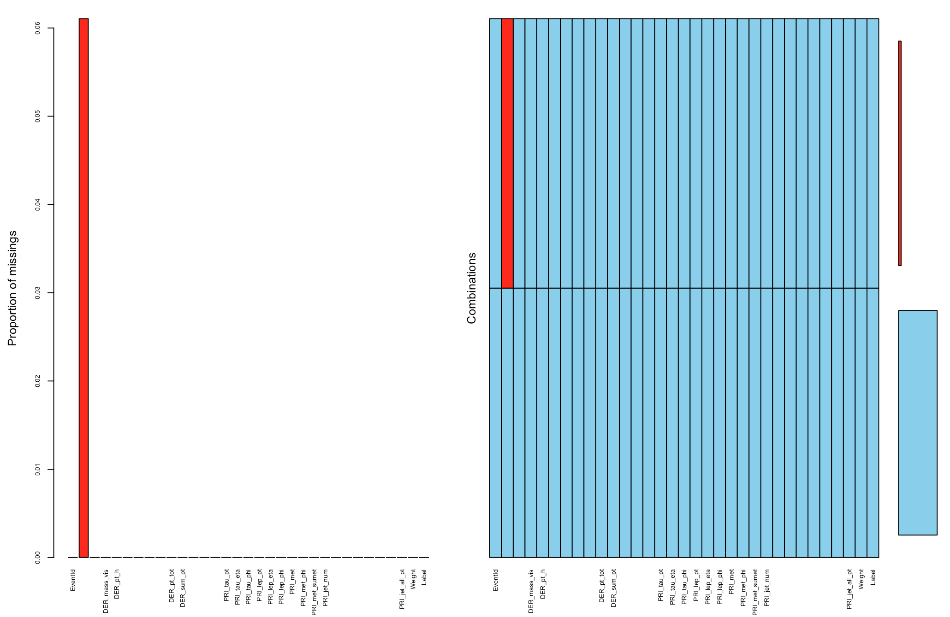
EDA -- Missingness Imputation by kNN
PRI_jet_num = 0
PRI_jet_num = 1
PRI_jet_num = 2 or 3

Slide 5
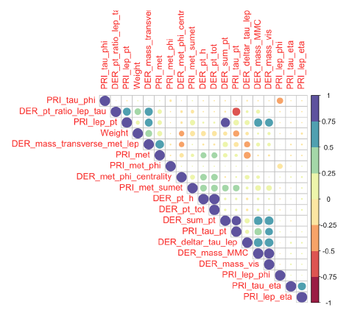
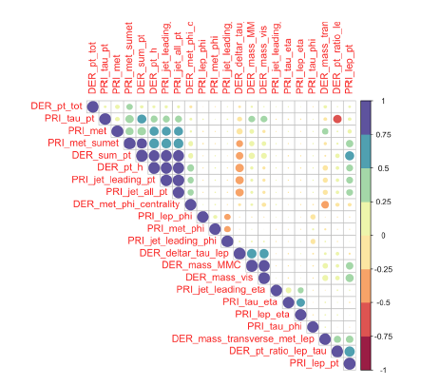
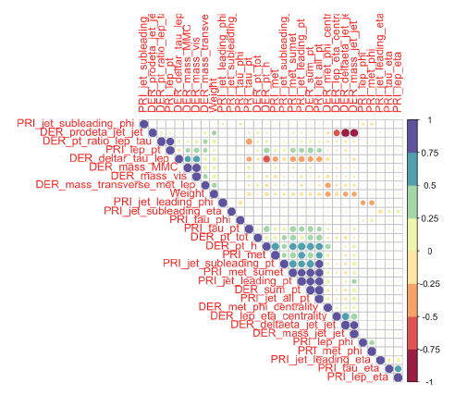
EDA -- Correlation
PRI_jet_num = 0
PRI_jet_num = 1
PRI_jet_num = 2 or 3
Variables of same prefix (with some uppercase letters) have high positive or negative correlation.

Slide 6
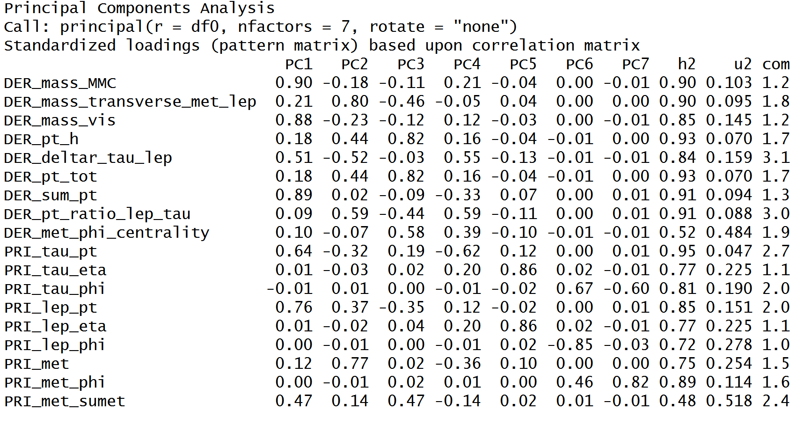
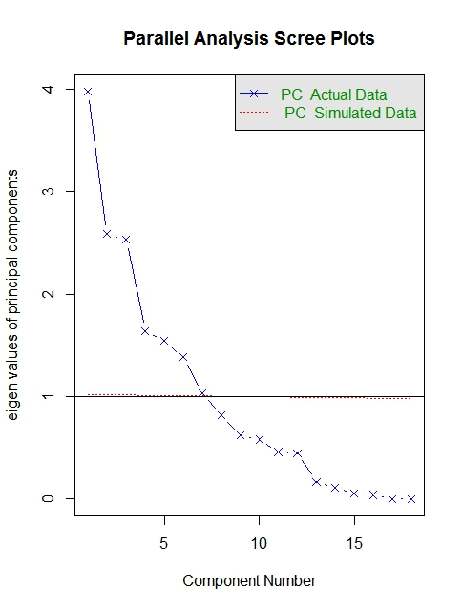
EDA -- Principal Component Analysis
Importance: mass-related variables.
Impute missing values: DER_mass_MMC
Notes:
Principal component analysis was conducted in each category.
Rotations(or loading) results, which are the coefficients of the linear combinations of the continuous as shown above.

Slide 7
Outline
Workflow
Exploratory Data Analysis
Models
Random Forests
Generalized Boosted Model
Neural Networks
XGBoost
Lesson Learned

Slide 8
Random Forests
Two parameters: ntree and mtry.
1st tuning: ntree = c(2000,5000,8000) mtry = c(3,4,5,6)
However, R crushed due to large computation
2nd tuning: ntree = c(500,800,1000) mtry = c(3,4,5)

Slide 9
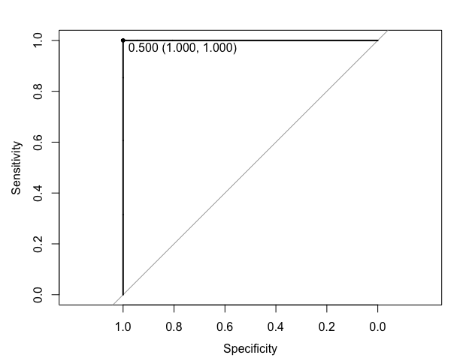
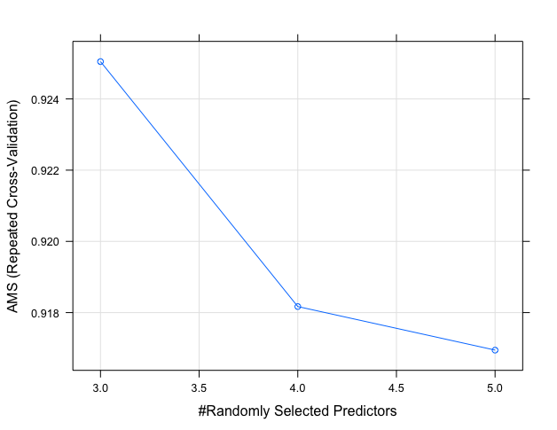
Random Forests(DF:PRI_jet_num=0, ntree = 1000)

Slide 10
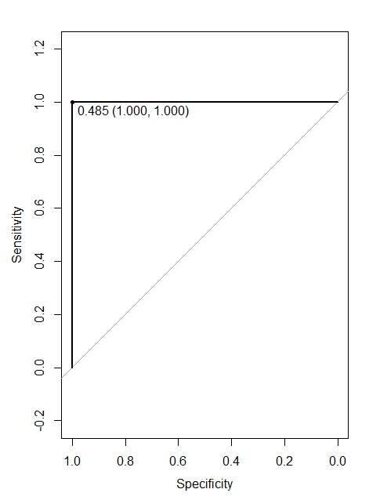
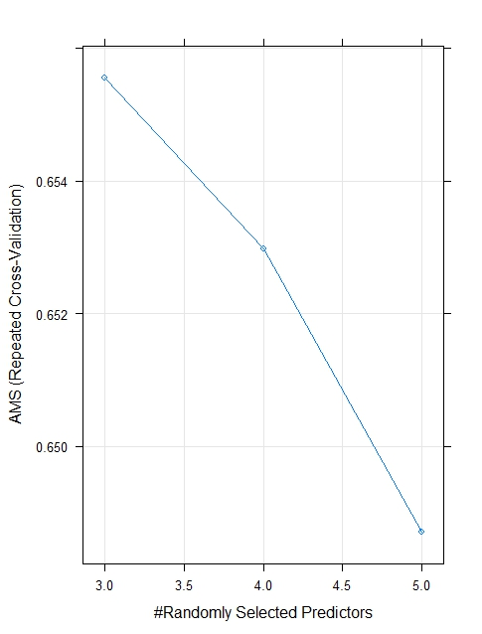
Random Forests(DF:PRI_jet_num=1, ntree = 1000)

Slide 11

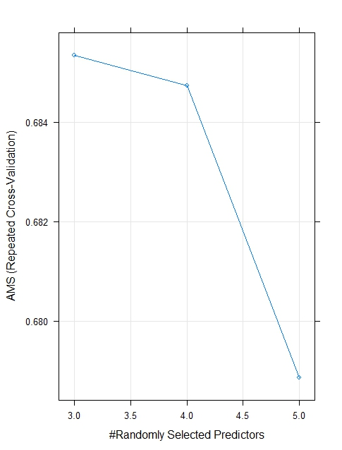
Random Forests(DF:PRI_jet_num=2&3, ntree = 1000)

Slide 12
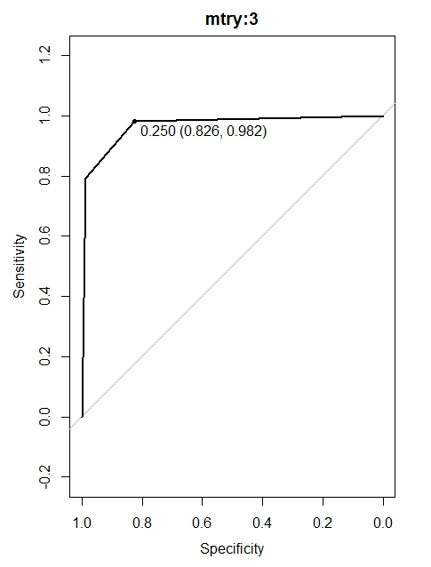
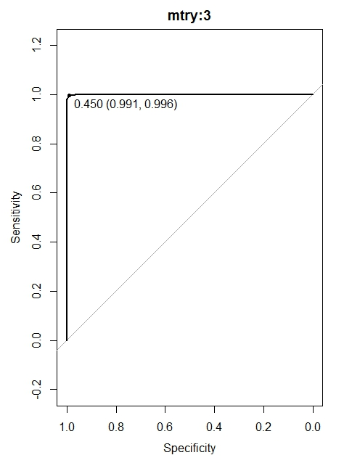
Random Forests(PRI_jet_num=2&3, ntree = 2 & 10)

Slide 13
Random Forests---Summary
Pros:
Theoretically, it can never overfit
Good with very large data set
Robust against outliers
Cons:
Not a fast algorithm. Very time and memory space consuming
Less accurate than boosted tree models
Cannot handle NAs

Slide 14
Outline
Workflow
Exploratory Data Analysis
Models
Random Forests
Generalized Boosted Model
Neural Networks
XGBoost
Lesson Learned

Slide 15
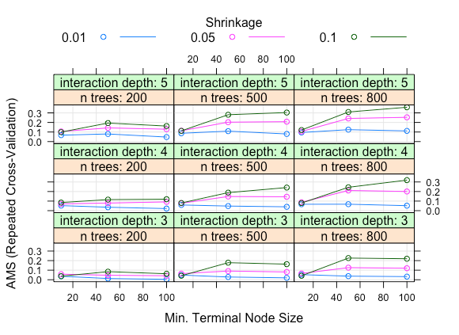
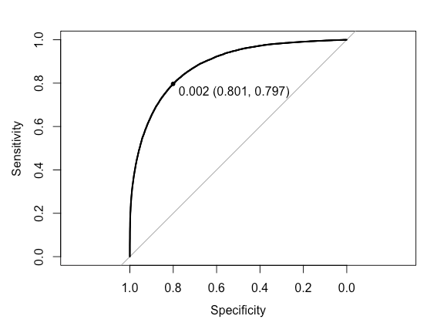
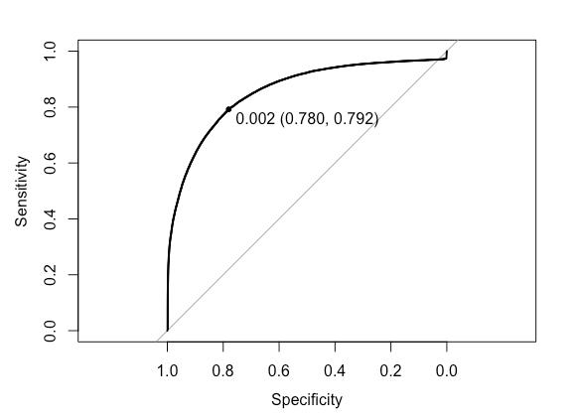
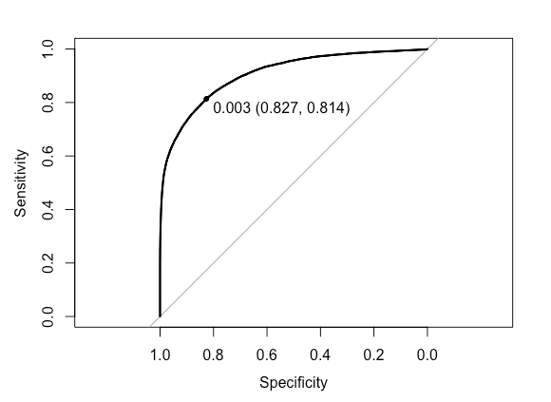
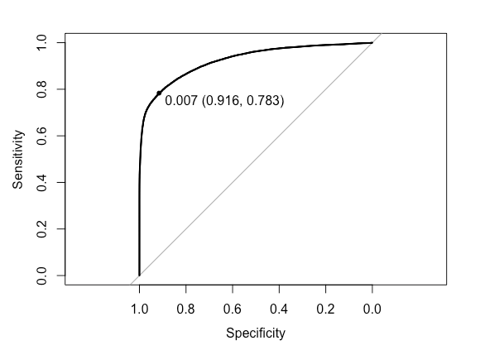
Gradient Boosting Model (DF:PRI_jet_num=1)
Tuning | AUC
1 | 0.88
2 | 0.86
3 | 0.91
4 | 0.93
1
Tuning four parameters, 5-fold validation
1st tuning: interaction.depth =c(3, 4, 5), n.trees =c(200, 500, 800), shrinkage = c(0.1, 0.05, 0.01), n.minobsinnode = c(10, 50, 100)
2nd tuning: 800 trees and interaction.depth (5,7,10)
3rd tuning: 5 interaction.depth and large trees(800, 2000, 5000)
4th tuning: 5 interaction.depth and larger trees(5000, 7500, 10000)
1
2
3
4

Slide 16
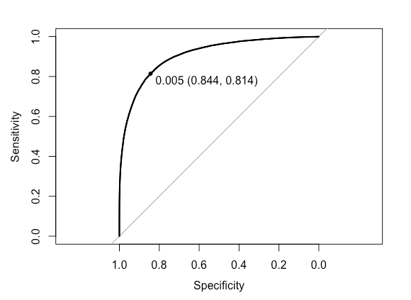
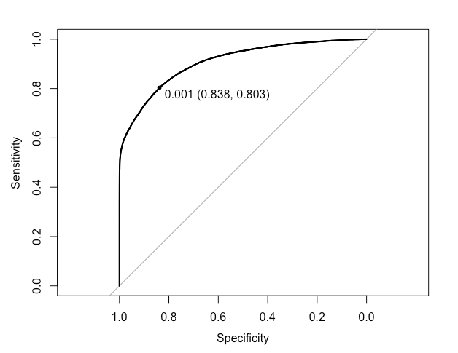
Parameter tuning for the other 2 subsets
jet_num=0
interaction.depth = 5, n.trees =10000, shrinkage = 0.1, n.minobsinnode = 100
AUC=0.907
jet_num=c(2,3)
interaction.depth = 5, n.trees =800, shrinkage = 0.05, n.minobsinnode = 100
AUC=0.91

Slide 17
Summary of Gradient Boosting Model
Insight:
Interaction.depth: sqr(number of variables)
N.trees: 10000, reduce overfitting by smaller learning rate and cross-validation
Shrinkage: big trees: 0.001; small trees: 0.1
N.minobsinnode: 100: reduce variance in predictions at leaves
Cons:
Susceptible to outliers
Lack of interpretability and higher complexity
Harder to tune hyperparameters than other models
Slow to train
Pros:
Use all features
Higher accuracy and lower possibility of overfitting with more trees

Slide 18
Outline
Workflow
Exploratory Data Analysis
Models
Random Forests
Generalized Boosted Model
Neural Networks
XGBoost
Lesson Learned

Slide 19
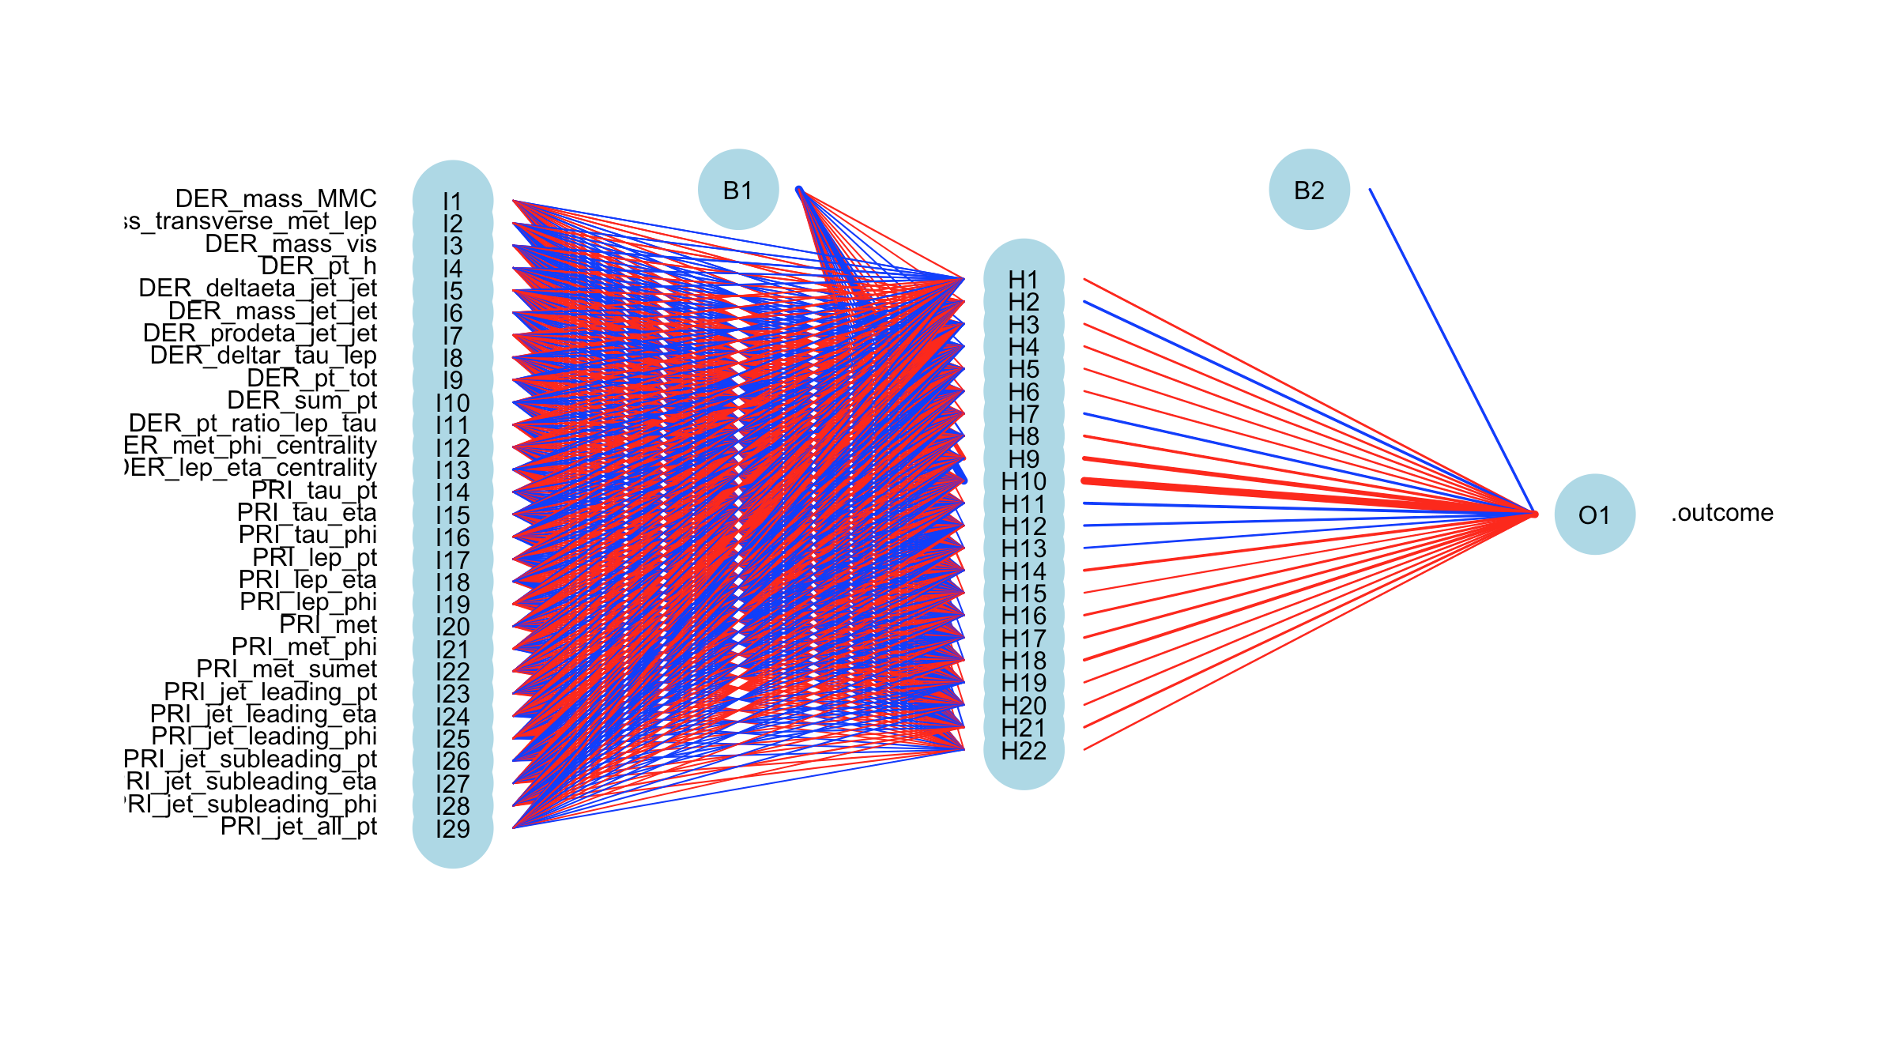
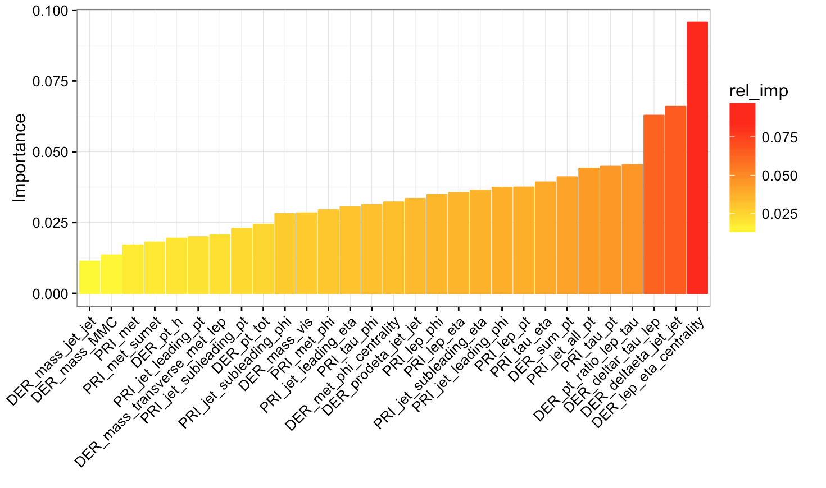
Neural Networks
Single hidden layer NN model “nnet” under “Caret” library.
Two tuning parameters: number of hidden units and weight decay.
Select initial combinations of ranges of hidden units between 6-20, and decay weights between 0-0.5.

Slide 20
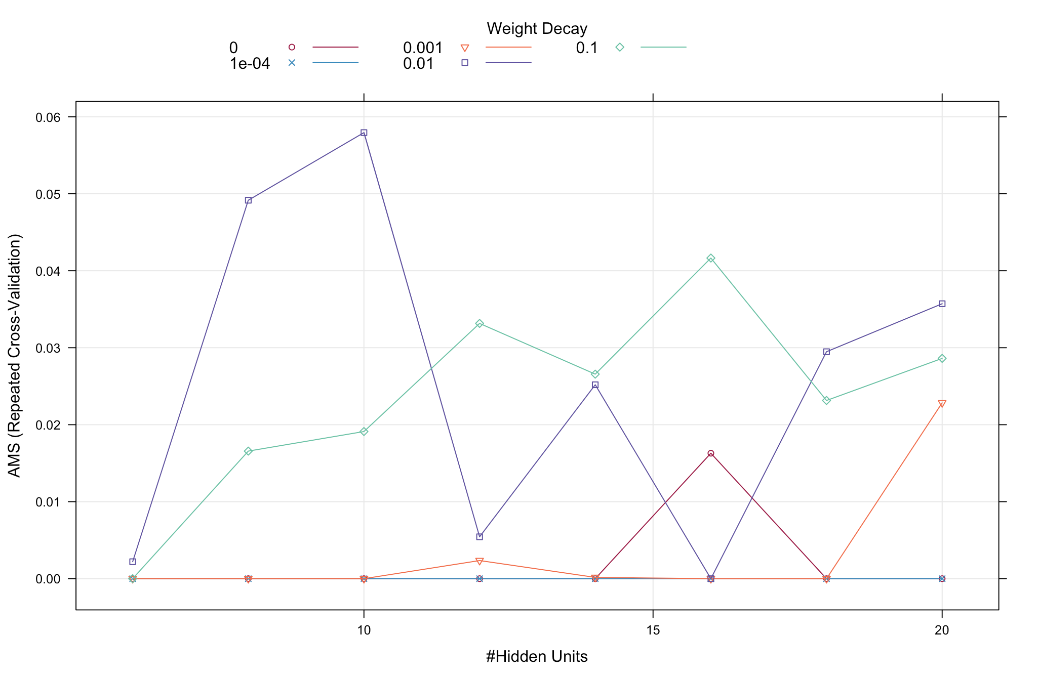
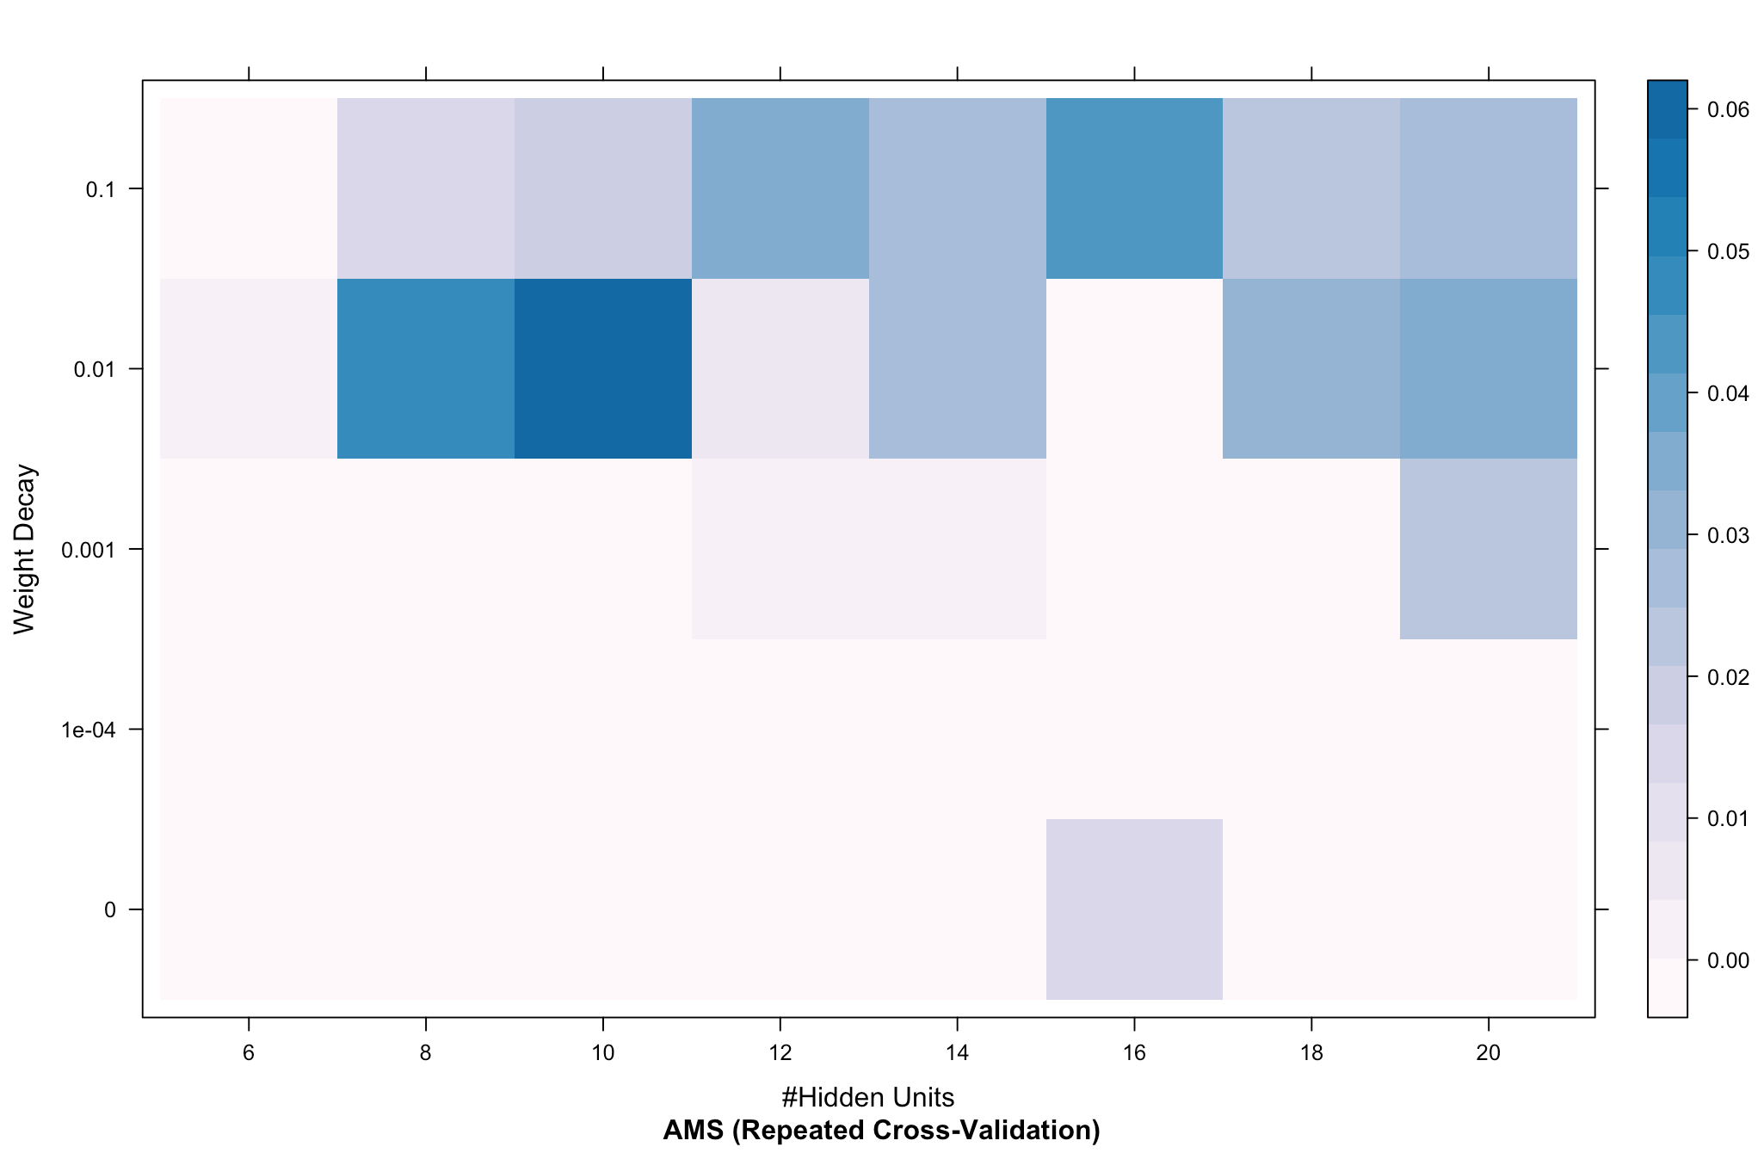
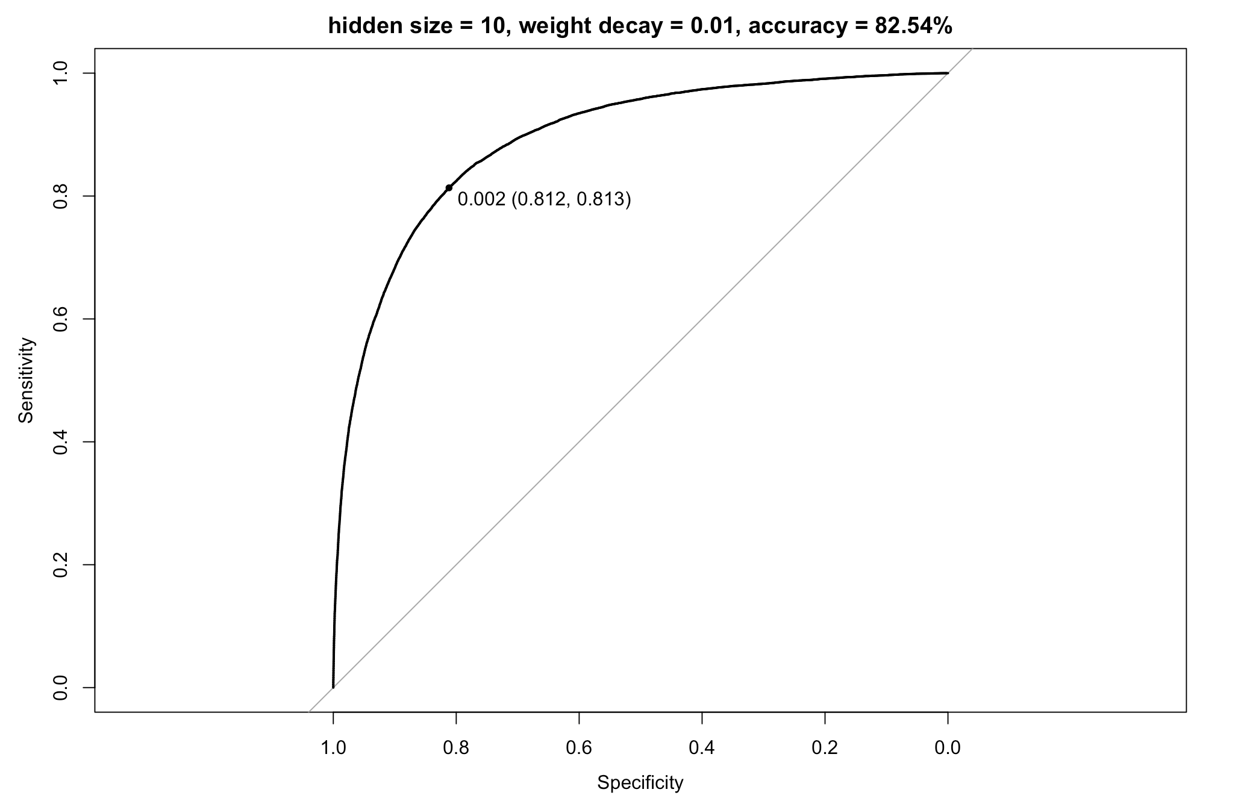
Neural Networks -- jet_number = 0
Best set:
hidden size =10; weight decay=0.01
Hidden units: seq(6,20,2); Weight decay: c(1e-04, 1e-03,0.01,0.1,0).
Fluctuation trend of AMS is noticed as hidden unit increases.

Slide 21
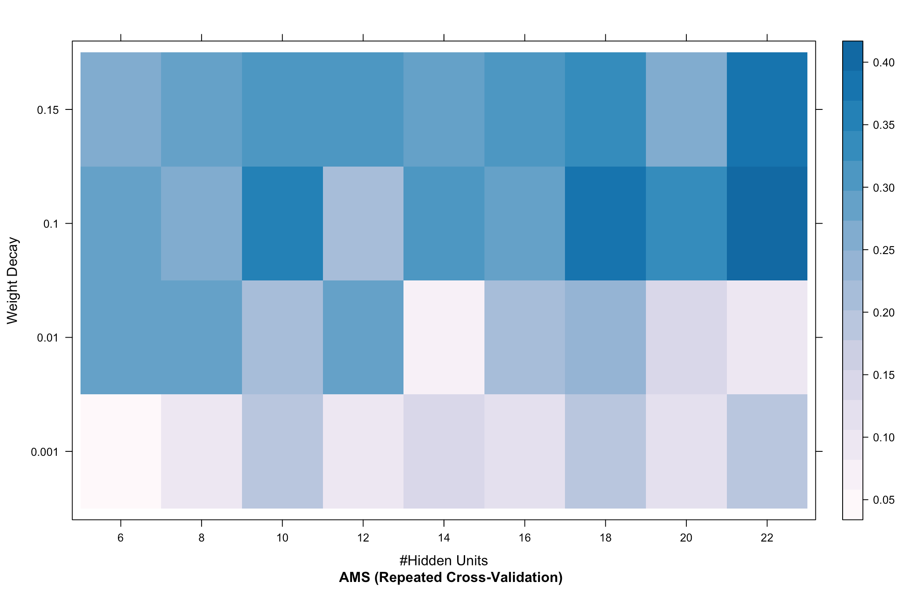
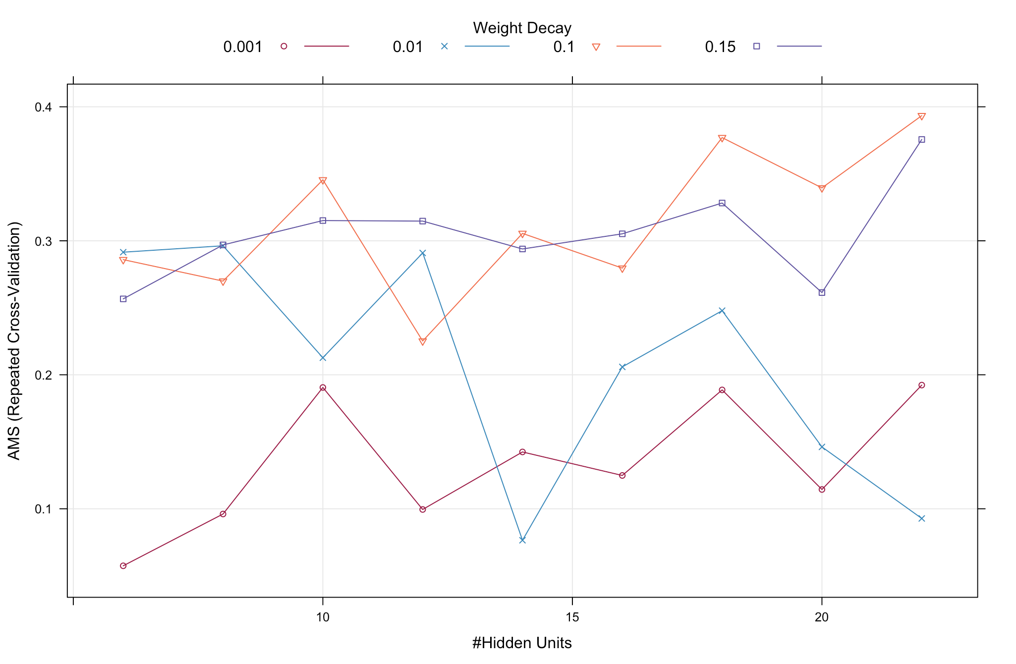
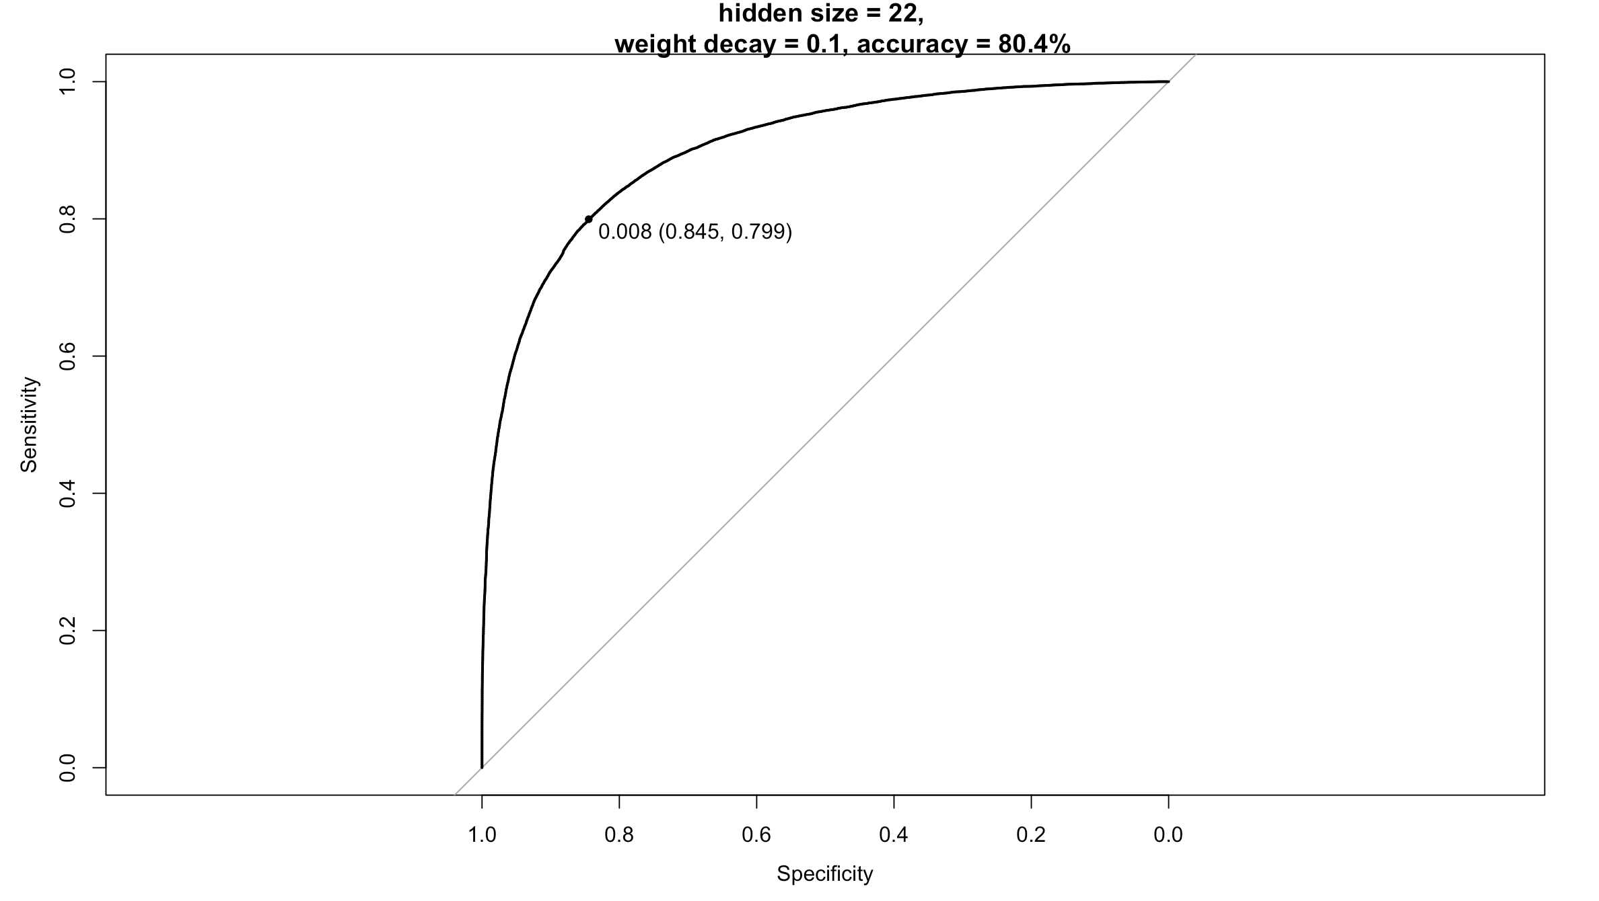
Neural Networks -- jet_number = 2/3
Best set:
hidden size =22; weight decay=0.1
Hidden units: seq(6,22,2); Weight decay: c(1e-03,0.01,0.1,0.15).
AMS steadily increases as more hidden units used.

Slide 22
Neural Networks -- Summary
Insight
Best performance when weight decay = 0.1 or 0.15.
More hidden nodes may be required.
Pros & Cons
Can handle hundreds or thousands of input variables.
Once trained, predictions are fast.
Training is computationally expensive.
Need a portion of the data for validation during NN training.

Slide 23
Outline
Workflow
Exploratory Data Analysis
Models
Random Forests
Generalized Boosted Model
Neural Networks
XGBoost
Lesson Learned

Slide 24
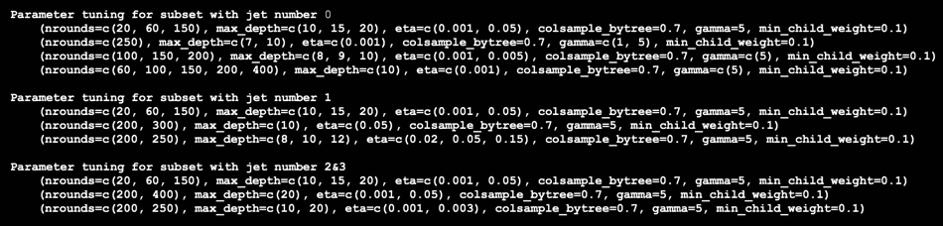
XGboost
6 parameters to tune
nrounds
max_depth
eta
colsample_bytree
gamma
min_child_weight
Guidelines
Begin with rough grid, gradually fine tuning
Prefer slow learners (small eta, eg. 0.005)
Tune max_depth (9 or 10)
Fixed colsample_bytree (0.7)
Fixed gamma (5)
Fixed min_child_weight (0.1)

Slide 25
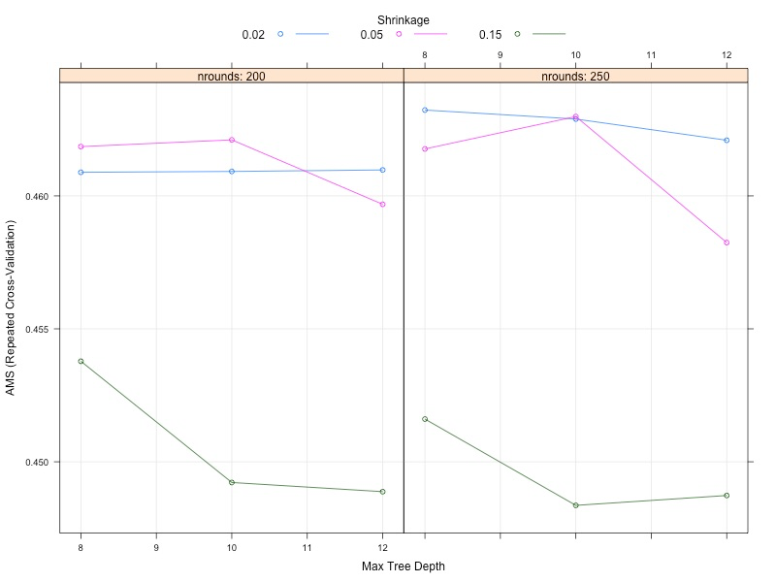
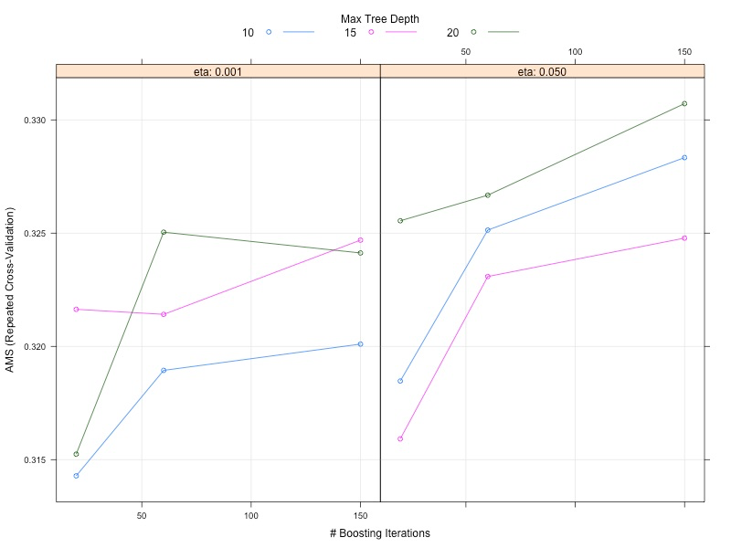
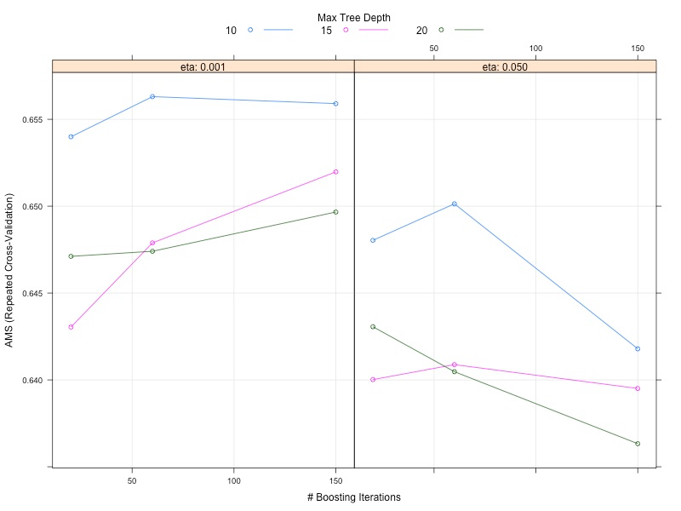
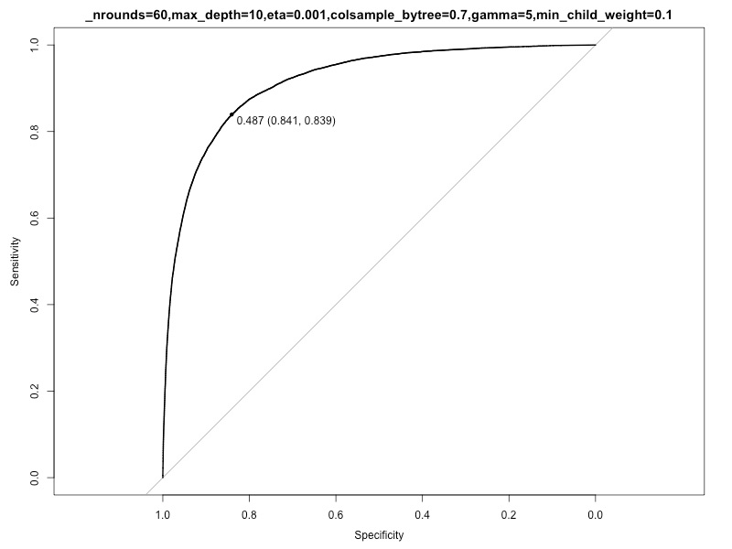
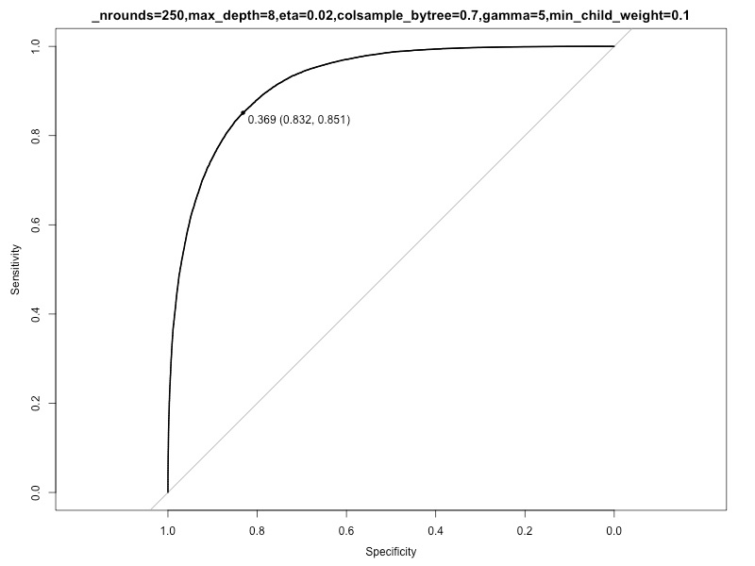
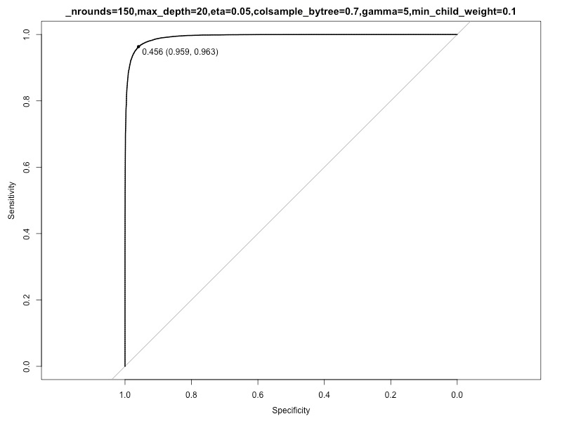
Parameter tuning for all 3 subsets

Slide 26
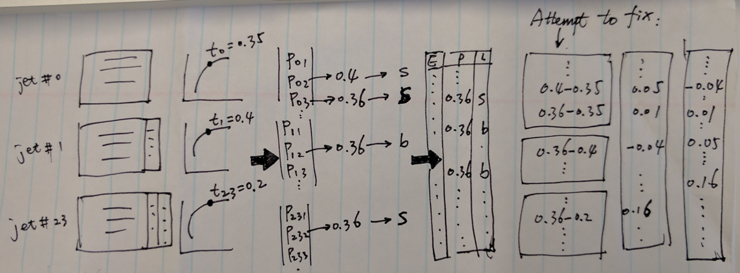
When combining all predictions ...

Slide 27
Outline
Workflow
Exploratory Data Analysis
Models
Random Forests
Generalized Boosted Model
Neural Networks
XGBoost
Lesson Learned

Slide 28
Lesson learned
Prioritize team's overall strategy.
Imputation turns out to be necessary for us (for EDA, feature importance, NN, RF).
Use cloud computing for all team members not their own laptops (avoid crashing and uncertainties).
Try larger grids if possible (our grids are still too sparse).
All team members focus on one model VS each work on their own.

Slide 29
Lesson learned
What we did good?
- Had clear and solid plan at the beginning
- Each team member is very dedicated to the project
- Pinpoint bottlenecks early and react very fast
- Tuned large amount of parameter combinations
What we can improve?
Team shifted focus twice
-Monday - Wednesday (EDA, Imputation, Importance analysis, Brainstorming)
Thursday (Gave up imputation, tuned on complete training dataset)
Friday (found NN and DF cannot handle missingness well; impute again on split data)
Saturday (Re-tuning)
Sunday (Had issue to combine the optimal results from split dataset)
Each member spend many time on tuning, less time on combining

Slide 30
Thanks!

